Slide 1


On the Hardness of Optimal Vertex Relabeling and Restricted Vertex Relabeling
Amihood Amir
Benny Porat

Slide 2


Historical Connection
We will go for the oldest references we can…

Slide 3
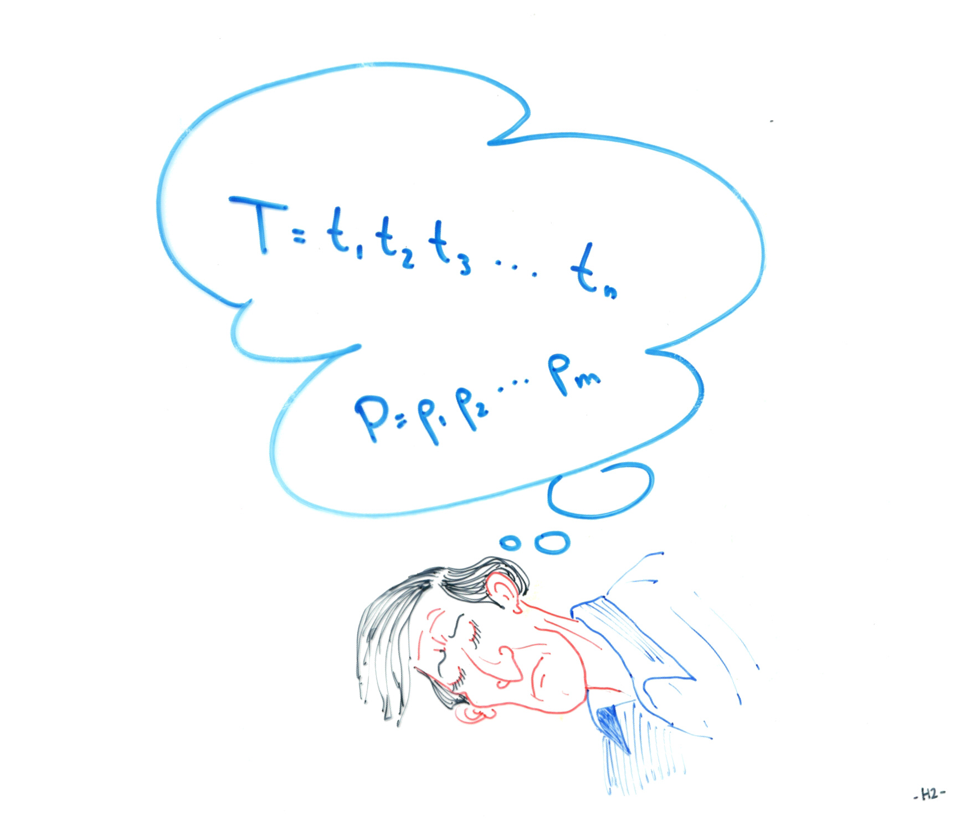
Motivation

Slide 4


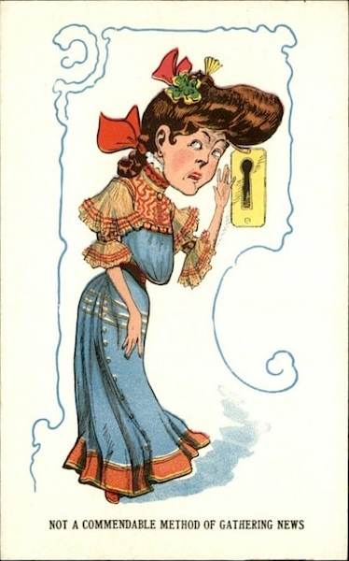

No Wonder…

Slide 5
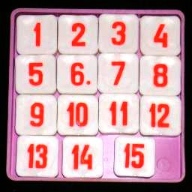
15-Puzzle

Slide 6
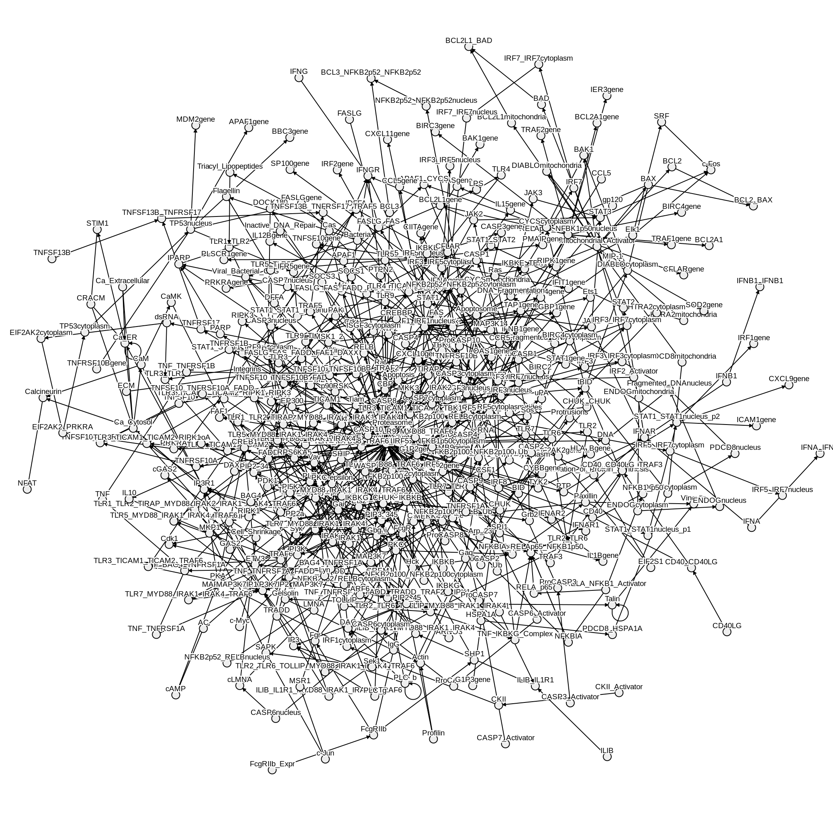
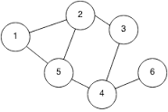
We would like…
T=
P=
HCE
ABC
DRWX
BBD
B_
AB_XY

Slide 7
Problem!!!
Subgraph isomorphism
is
NP-hard

Slide 8
Historical solutions:
Manber and Wu (1992): model for matching strings in graphs (hypertext).
Akutsu (1993): matching strings in trees.
Park and Kim (1995): matching strings in acyclic graphs.
A., Lewenstein and Lewenstein (2000): matching strings in general graphs – exact and approximate.
Navarro (2000): appx matching of strings in graphs, improved time bounds.
A. and Navarro (2009): parameterized matching in hypertext.

Slide 9



What about graphs in graphs?
C
V1
B
V2
V1
C
V6
B
A
V3
A
V4
V4
V2
B
B
V5
A
B
V5
V3
Are they equal?
Trivial
B
V6

Slide 10
What about approximations?
C
V1
B
V2
V1
C
V6
B
A
V3
B
V4
V4
V2
B
B
V5
A
A
B
V5
V3
Hamming distance:
Trivial
B
V6

Slide 11
Vertex Relabeling
Transform one graph to another via swaps of adjacent labels.

Slide 12
Vertex Relabeling
V1
C
V6
B
A
What is the distance?
V4
V2
B
B
V5
A
A
V1
V6
B
V3
V3
B
V4
V2
C
B
V5
A
V3

Slide 13
Vertex Relabeling
V1
C
V6
B
V1
C
V6
B
A
B
V4
V4
V2
B
B
V5
V2
A
V5
B
A
A
V1
V6
B
V3
A
V3
B
V4
V2
C
B
V5
A
V3

Slide 14
Vertex Relabeling
V1
C
V6
B
V1
C
V6
B
A
B
V4
V4
V2
B
B
V5
V2
A
V5
B
A
A
V1
V6
B
V3
A
V3
B
V4
V2
C
B
V5
distance = 2
A
V3

Slide 15

Connection to 15-puzzle
3
1
9
15
10
6
11
7
12
*
4
14
3
8
13
5
*
Only the can be swapped

Slide 16
History
Kantabutra (2007): polynomial time algorithms for path graphs and trees.
Agransson, Greenlaw, Kantrabutra (2010): connection between vertex relabeling and edge relabeling, upper and lower bounds on possible distances.

Slide 17
Our Contributions:
Vertex relabeling on a path graph is really the swap matching problem for which we have a rich history.
Compare the graph problem and the string problem.
Show that vertex relabeling on a graph is NP-hard.
Define the concept of restricted swaps.
Show that if we restrict every vertex to a single swap, the problem is polynomial time computable.

Slide 18
History (last time this talk):
Muthu (1995): defined swap matching problem.
AALLL (1997), ALLL(1998), ACHLP (2003): culminates in O(n polylog m) time swap matching algorithm.
A., Lewenstein and Porat (2002): approximate swap matching.
A., Eisenberg and Porat (2006): swap and mismatch edit distance.

Slide 19
The Decision Problem
Input: A graph with two vertex labelings L and L’.
Decide: Can the graph be relabeled from L to L’? i.e., can one achieve labeling L’ from L by swapping the labels of adjacent vertices?
We show:

Slide 20
The Decision Problem
Theorem: A graph can be relabeled from L to L’ iff L and L’ have the same histogram.
i.e. If the set of labels in both labelings is the same, and every label appears the same number of times in both labelings.
Proof: On any path, the labels on its ends can be exchanged via a series of swaps without changing any other labels.

Slide 21

The Decision Problem
Example:
A B C D E F G
Exchange these two

Slide 22
The Decision Problem
Example:
A B C D E F G

Slide 23
The Decision Problem
Example:
B A C D E F G

Slide 24
The Decision Problem
Example:
B A C D E F G

Slide 25
The Decision Problem
Example:
B C A D E F G

Slide 26
The Decision Problem
Example:
B C D A E F G

Slide 27
The Decision Problem
Example:
B C D E A F G

Slide 28
The Decision Problem
Example:
B C D E F A G

Slide 29
The Decision Problem
Example:
B C D E F G A

Slide 30
The Decision Problem
Example:
B C D E G F A

Slide 31
The Decision Problem
Example:
B C D G E F A

Slide 32
The Decision Problem
Example:
B C G D E F A

Slide 33
The Decision Problem
Example:
B G C D E F A

Slide 34
The Decision Problem
Example:
G B C D E F A

Slide 35
The Decision Problem
Example:
G B C D E F A
These two were exchanged. All others back in place.

Slide 36
The Relabeling Optimization Problem
Input: Graph G with labels L and L’.
Output: The minimum number of swaps t, necessary for relabeling G from L to L’.
Claim: The Relabeling Optimization problem is NP-hard.

Slide 37
The Reduction
From the Interchange Distance Problem:
Interchange Rearrangement Problem:
Use interchanges to rearrange elements, from input to output string.
The problem: find distance
(=minimum cost).
A
A
A

Slide 38
Example:
A B B A C D
Input:
A C B D A B
A B B A C D

Slide 39
Example:
A B B A C D
Input:
A C B D A B
A B B A C D A C B A B D

Slide 40
Example:
A B B A C D
Input:
A C B D A B
A B B A C D A C B A B D A C B D B A

Slide 41
Example:
A B B A C D
Input:
A C B D A B
A B B A C D A C B A B D A C B D B A
A C B D A B

Slide 42
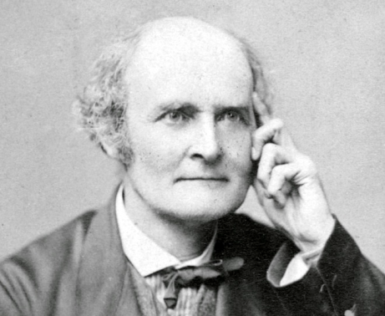
Interchange Distance
Finding the interchange distance was an open problem of Cayley in 1849.
Theorem [A., Hartman, Kapah, Levy, Porat (2009)] :
Computing the interchange distance of two general strings is NP-hard
A
A
A

Slide 43
The Reduction (Proof by Example)
A B B A C D
Input:
A C B D A B
The interchange distance is t
iff
There is a relabeling distance t
V1
A
D
V6
V1
A
B
V6
C
V5
V2
C
A
V5
V2
B
B
A
V3
B
D
V4
V3
V4

Slide 44
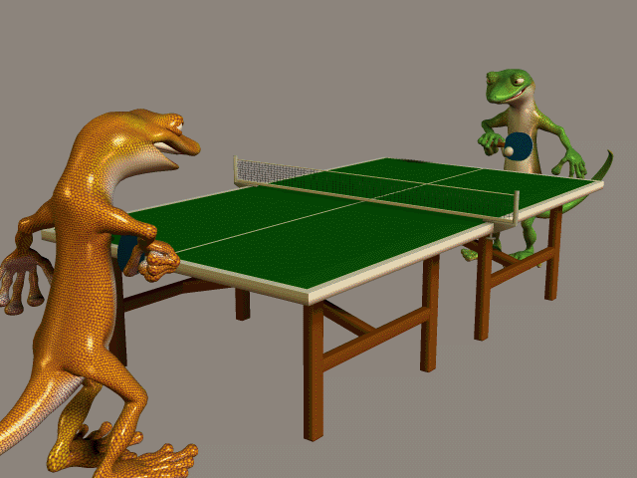
Pattern Matching helped Vertex Relabeling …
What can Pattern Matching learn from Vertex Relabeling?

Slide 45
The Swap Matching Restriction
Swap matching was defined such that every element participates in at most one swap.
What happens if we relax this restriction?
The Question: Given two strings with the same histogram (every symbol appears the same number of times in each) what is the minimum number of swaps needed to transform one to the other?

Slide 46
The Unique Version of a String
We would like every symbol to be unique.
For string: A B B A C A B C C A B
The unique version is:
A₁ B₁ B₂ A₂ C₁ A₃ B₃ C₂ C₃ A₄ B₄
We can now assume that each symbol appears in every string only once.

Slide 47
Inversion
Given two strings S and T
An inversion is a pair of indices (i,j),
where i>j and
S[i] appears before S[j] in T.
Example: S= A B C F E D
T = A B C D E F
There are 3 inversions (F,E), (E,D), and
(F,D).

Slide 48
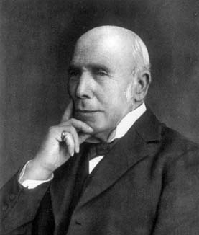
Muir’s Theorem (1882)
Given strings S and T of length n,
the minimum number of swaps necessary to transform S to T is the number of inversions.
In the Example:
S= A B C F E D
T = A B C D E F
3 inversions = 3 swaps

Slide 49
Algorithm for Finding Number of Inversions
S = 1 2 3 4 5 6 7 8 9 . . . k
T = n₁ n₂ … n_{j} … n_{i} … n_{m} … n_{k}
add j-1 inversions
i-1 inversions

Slide 50
Algorithm for Finding Number of Inversions
S = 1 2 3 4 5 6 7 8 9 . . . k
T = n₁ n₂ … n_{j} … n_{i} … n_{m} … n_{k}
Keep track of this
via some dynamic structure, e.g. AVL tree.
Thus
i-1 inversions
add m-1 inversions minus 1
Algorithm time: O(k log k)

Slide 51
Back to Vertex Relabeling
What happens if we restrict a label swap to 1? (linear time in strings…)
Theorem:
Vertex relabeling restricted by 1 is equivalent to perfect matching in bipartite graphs.

Slide 52
Vertex Relabeling to Perfect Matching
Reduction construction:
For every edge uv where
L(u)=L’(v)=a and L(v)=L’(u)=b
Put u in X and v in Y and an edge between them.
‾

Slide 53

Vertex Relabeling to Perfect Matching
V1
A
B
V6
V1
B
A
V6
A
V5
V2
A
B
V5
V2
C
B
A
V3
A
C
V4
V3
V4
V1
A
B
V6
V5
A
B
V3
V2
C
A
V4

Slide 54
Perfect Matching to Vertex Relabeling
Reduction construction:
The graph is the same as the input bipartite graph.
The labels: L is 0’s in X and 1’s in Y
L’ is 1’s in X and 0’s in Y

Slide 55
Perfect Matching to Vertex Relabeling
0
1
1
0
L
0
1
L’
1
0
0
1
1
0

Slide 56
Time
Because the reductions are linear and the best known times for perfect matching in bipartite graph, the time for graph relabeling is:
O(E√V) or O(V^{2.376})
Because of the two-way linear reduction, this is a conditional lower bound.

Slide 57
Open Problems
1. k-swap matching in a pattern matching
sense – can it be done o(nm)?
2. k-distance vertex relabeling?
3. Approximations for the NP-hard vertex
relabeling problem.
4. Vertex relabeling as online problems –
where graphs are input one vertex at a
time.

Slide 58
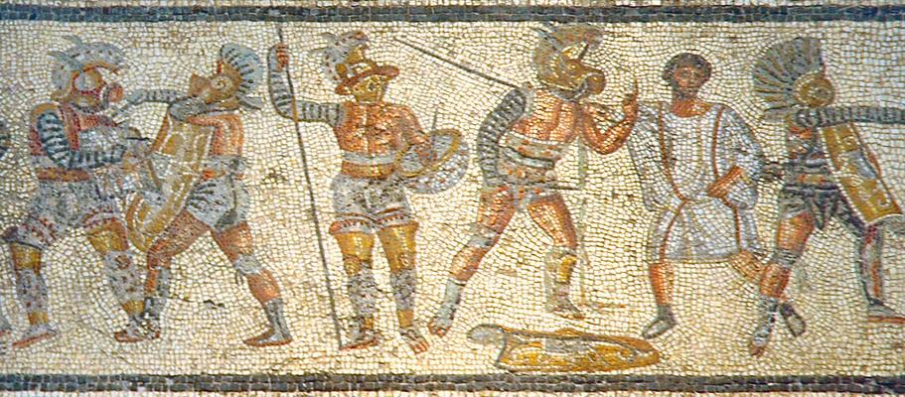
Grazie

